Slide 1

P peline
The Data
Assignment Handin & Peer Grading
© Jennifer Mankoff
The Data Pipeline; HCII; Spring 2014

Slide 2
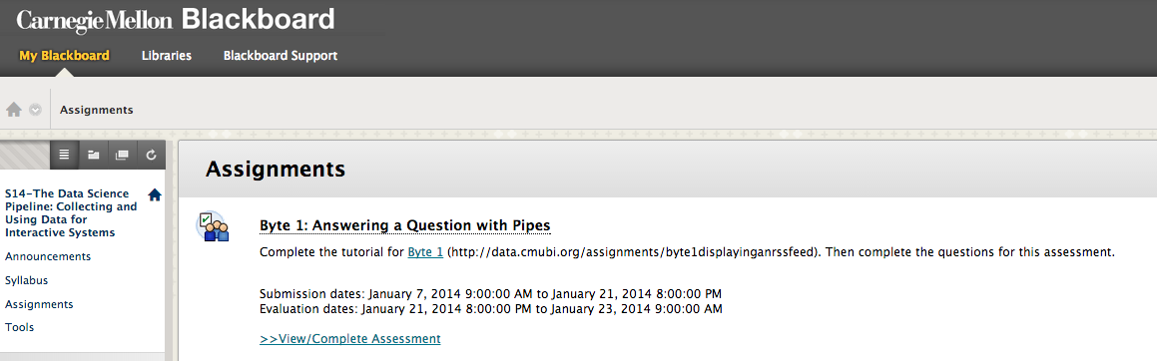
Handin on Blackboard

Slide 3
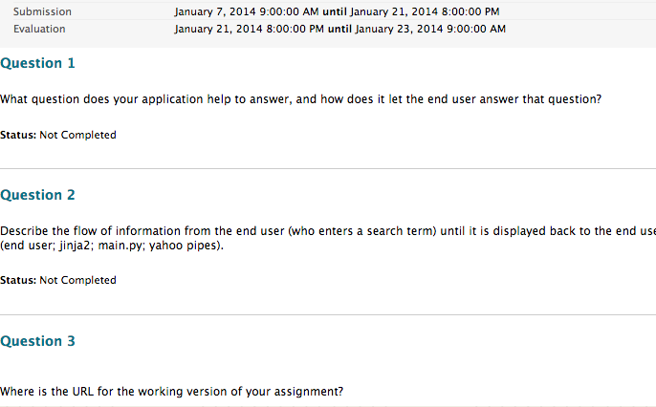
Answer Questions

Slide 4
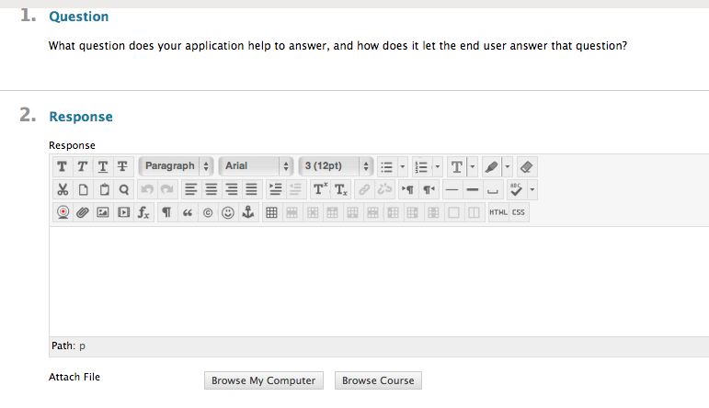
One at a time

Slide 5
Typical Criteria for written work:
Subject: Does the response accurately address the subject?
Depth of Response: Does the response provide an in-depth evaluation of the problem?

Slide 6
Typical Criteria for running code
Byte Functionality: Does the code run without errors?
Byte Functionality: Does the code successfully allow the end user to interact with the system and affect the results?
Byte Functionality: Does the code successfully display information taken from the source specified in the assignment?

Slide 7
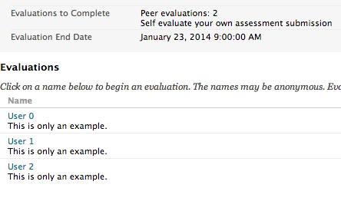
Peer grading

Slide 8
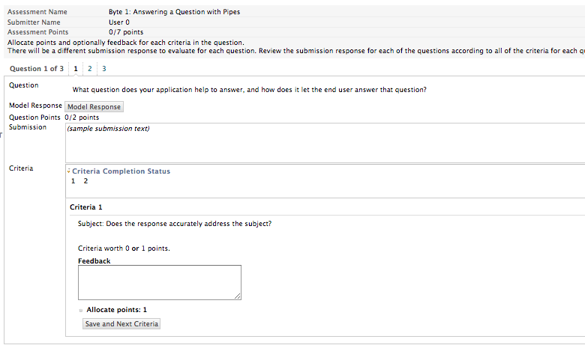
Per user

Slide 9
Per user

Slide 10
Per user

Slide 11
Per user

Slide 12
Per user

Slide 13
What makes good feedback?
Remember my code last class?
Correctly displayed news feeds about dogs
Correctly displayed news feeds about other single words
Crashed when I used a space

Slide 14
Things to think about
Points are easier than feedback
But don’t “double dock”
Feedback about something especially nice is helpful, feedback about points removed is essential

Slide 15
Let’s think of appropriate feedback
Byte Functionality: Does the code run without errors?
Byte Functionality: Does the code successfully allow the end user to interact with the system and affect the results?
Byte Functionality: Does the code successfully display information taken from the source specified in the assignment?

Slide 16
What makes good feedback about written work?
Criteria are generic
Subject: Does the response accurately address the subject?
Depth of Response: Does the response provide an in-depth evaluation of the problem?
What do they mean?
How do you grade them?

Slide 17
Example: What question does your application help to answer and how does it answer it?
Weak Answer: My application lets the user search for news articles
Criteria
Subject: Does the response accurately address the subject?
Depth of Response: Does the response provide an in-depth evaluation of the problem?

Slide 18
Example: What question does your application help to answer and how does it answer it?
Weak Answer: My application lets the user search for news articles
Criteria
Subject: Does the response accurately address the subject?
This answer is not really on topic. It says what the user can do, but not what sorts of questions they can ask or how the system answers them. 0pts
Depth of Response: Does the response provide an in-depth evaluation of the problem?
This answer does not provide any depth. 0pts

Slide 19
Example: What question does your application help to answer and how does it answer it?
Medium Answer: My application lets the user ask what is going on in the news about a certain topic by searching for it
Criteria
Subject: Does the response accurately address the subject?
Depth of Response: Does the response provide an in-depth evaluation of the problem?

Slide 20
Example: What question does your application help to answer and how does it answer it?
Medium Answer: My application lets the user ask what is going on in the news about a certain topic by searching for it.
Criteria
Subject: Does the response accurately address the subject?
This answer is on topic. It talks about what question and how. 1 pt
Depth of Response: Does the response provide an in-depth evaluation of the problem?
This answer is fairly shallow. Without using the application I wouldn’t really know what it does. 0pt.
Notes:
This answer is a little better. It says something about what the user might ask (question) and how (searching)

Slide 21
Example: What question does your application help to answer and how does it answer it?
Strong Answer: A user can ask what the news is saying about different topics. When the user types in a search term, news articles with titles matching that term are displayed.
Criteria
Subject: Does the response accurately address the subject?
Depth of Response: Does the response provide an in-depth evaluation of the problem?

Slide 22
Example: What question does your application help to answer and how does it answer it?
Strong Answer: A user can ask what the news is saying about different topics. When the user types in a search term, news articles with titles matching that term are displayed.
Criteria
Subject: Does the response accurately address the subject?
Yes it describes a question and approach. 1pt.
Depth of Response: Does the response provide an in-depth evaluation of the problem?
Yes. The user experience is described in enough depth for me to imagine how it works. 1 pt

